Slide 1
Unix Environments
An Introduction with an MITgcm-specific example

Slide 2

Open Up a Unix Terminal
On a Mac, this is the default terminal
On Windows, there are two options
Option 1: Install WSL (Ubuntu, recommended)
WSL = Windows Subsystem for Linux
Option 2: Install Cygwin (if option 1 is not working)
Instructions for both options are on the course notes HERE
WSL

Slide 3
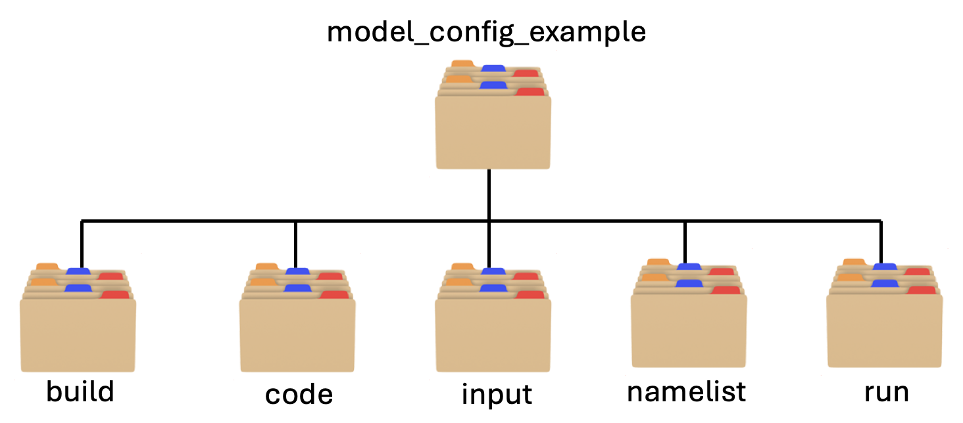
A Typical Model File Structure

Slide 4
Summary of Basic Unix Commands
Command | Description | Commonly-Used Options
pwd | Obtains the present working directory
ls | Lists the contents of a directory | -l (verbose) –a (show hidden)
cd | Changes the directory to a different location
cp | Copies a file from one location to another | -r (recursive)
ln | Links one file to another | -s symbolic
cat | Prints the contents of a file
head | Prints the contents at the start of a file | -n (number of lines)
tail | Prints the contents at the end of a file | -n (number of lines)
mkdir | Make a directory
rm | Remove a file from the system | -r (recursive)
rmdir | Remove a directory | -r (recursive)

Slide 5
🤔 Try it for yourself
All Unix commands have the following structure:
command (-options) [arguments]
Try the ls command with the following:
the –l option
the –a option
the Documents argument
the D* argument

Slide 6
🤔 Try it for yourself
Change your directory to the run directory of the model_config_example directory

Slide 7
🤔 Try it for yourself
Copy all the files starting with the characters data to the run directory

Slide 8
🤔 Try it for yourself
Symbolically link all of the files and folders in the input directory to the run directory

Slide 9
🤔 Try it for yourself
Create a file called notes.txt and add a couple notes

Slide 10
🤔 Try it for yourself
Edit your profile file with a welcome message to yourself

Slide 11
🤔 Try it for yourself
Delete all of the files in the build directory that start with the characters exf

